Slide 1
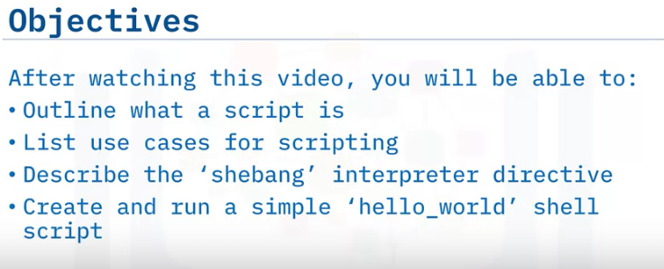
Introduction to Shell

Slide 2
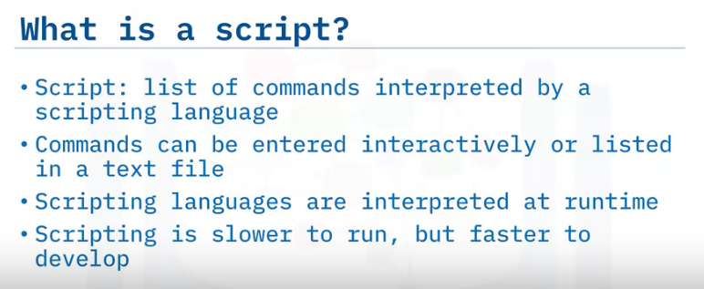
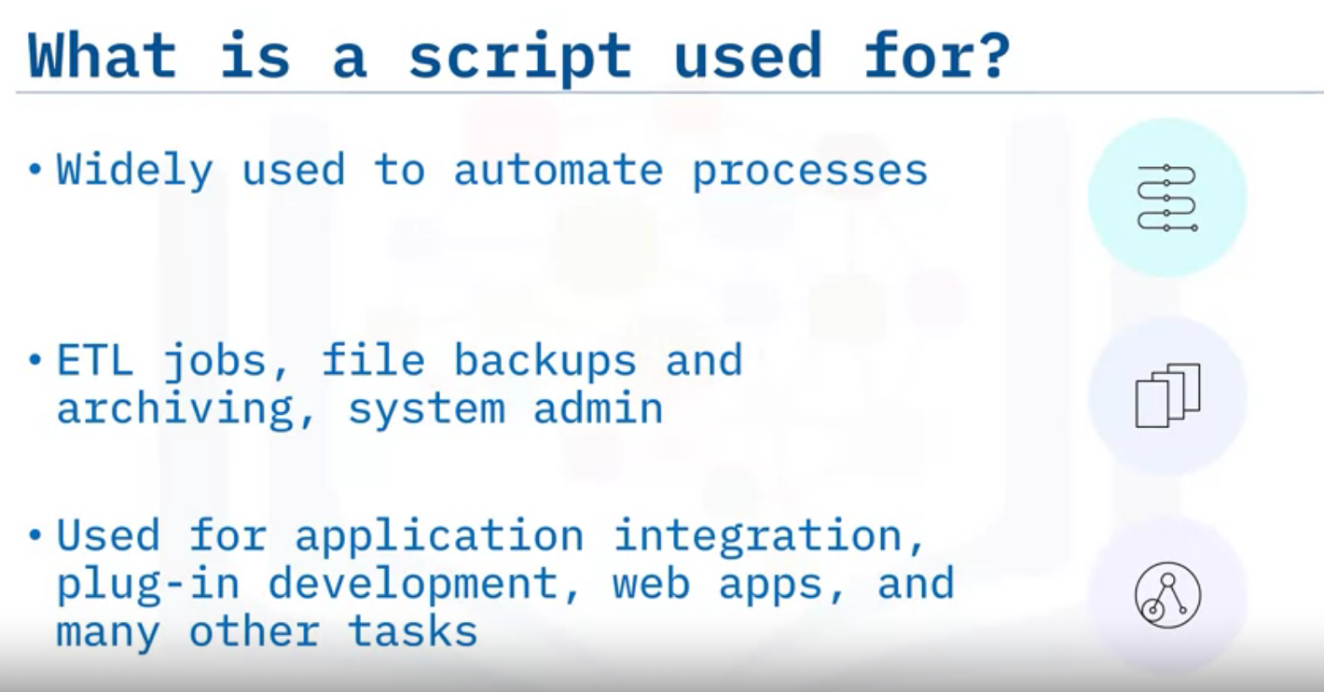

Slide 3
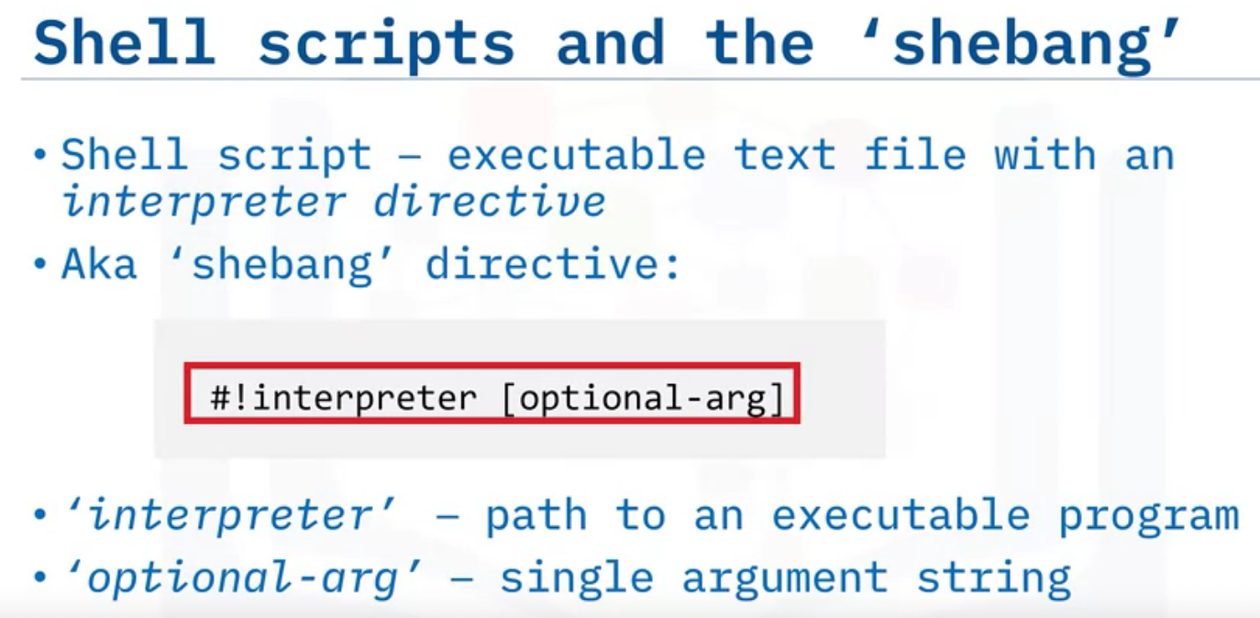
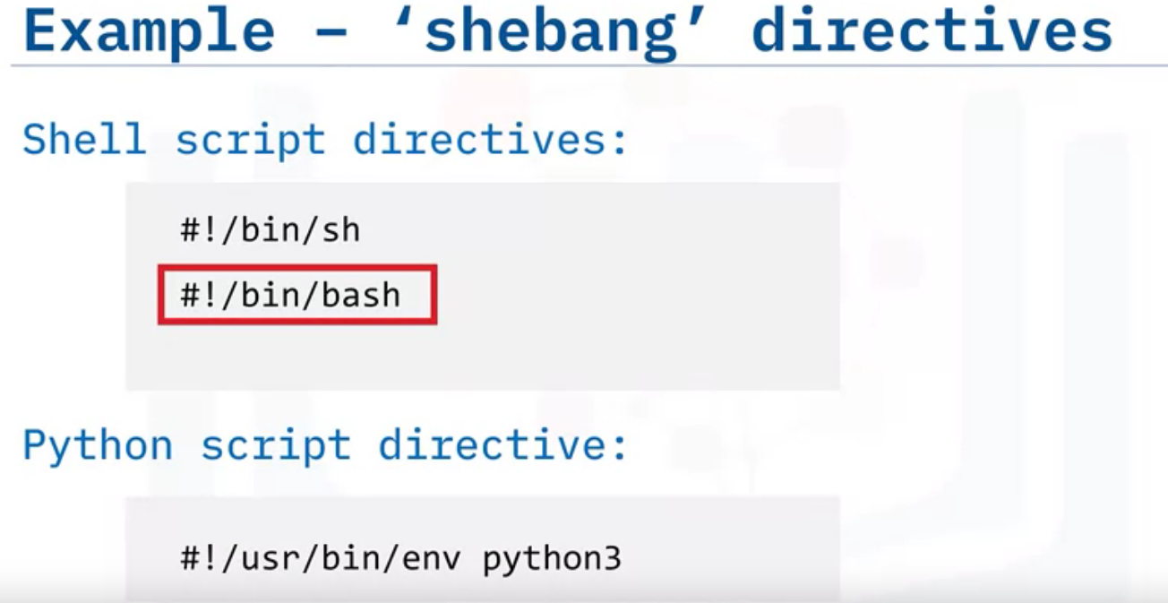

Slide 4
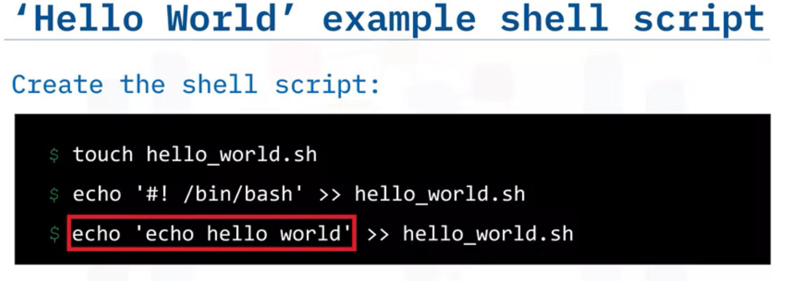
Creating a new shell script file.
Turturn your text file into a bash script by echoing the bash shebang, and appending that echoed text to your file using the ‘double greater than symbol,’ which is the Bash ‘output redirection’ operator used for appending output to file
Finally, use the echo command to print the statement ‘echo Hello World’ and again,
redirect that output to your bash script.

Slide 5
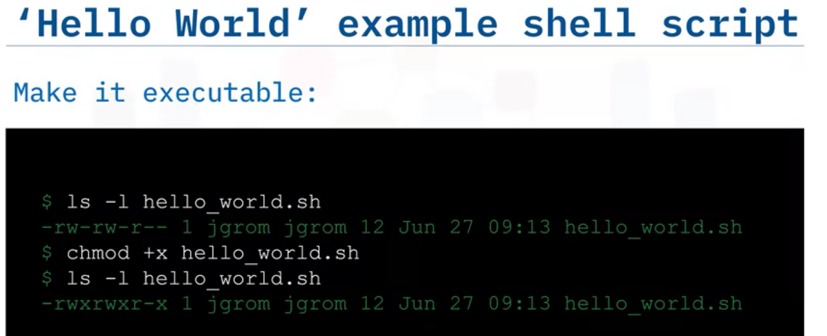
By using ‘ls –l’ we can check the existing permissions given to the file which is ‘rw’ and there is no ‘ X’ which mean executable
Rw-r-r : owner –group-user
In 2nd step we change the mode of the permissions with ‘chmod +x’ to make it executable.
Again in 3rd step, by using list ‘ls –l’ , we can confirm that permissions has been changed.

Slide 6
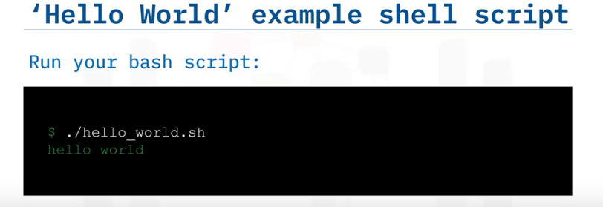
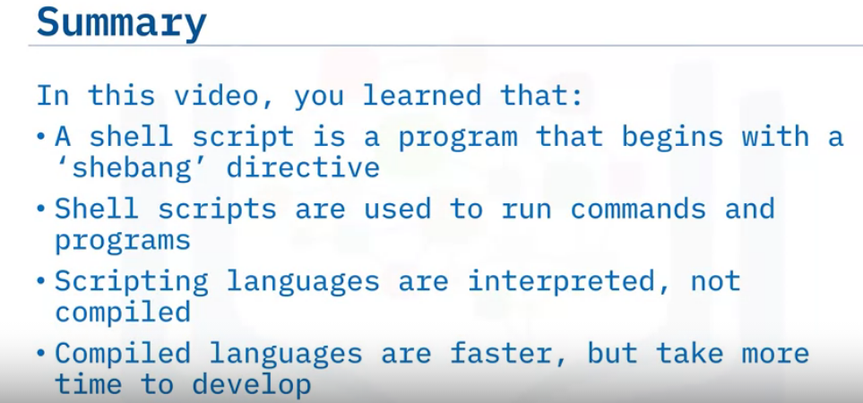
Finally, we can run the script in the command line as shown above.

Slide 7
Filters, Pipes & Variables

Slide 8
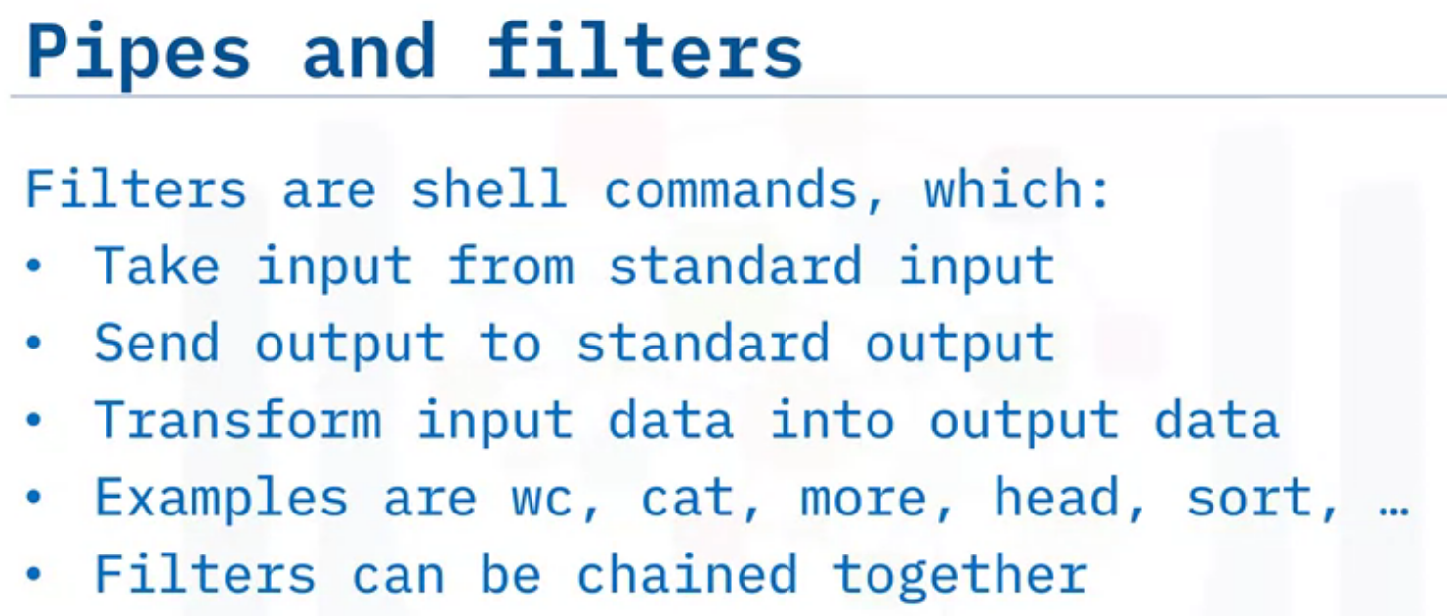
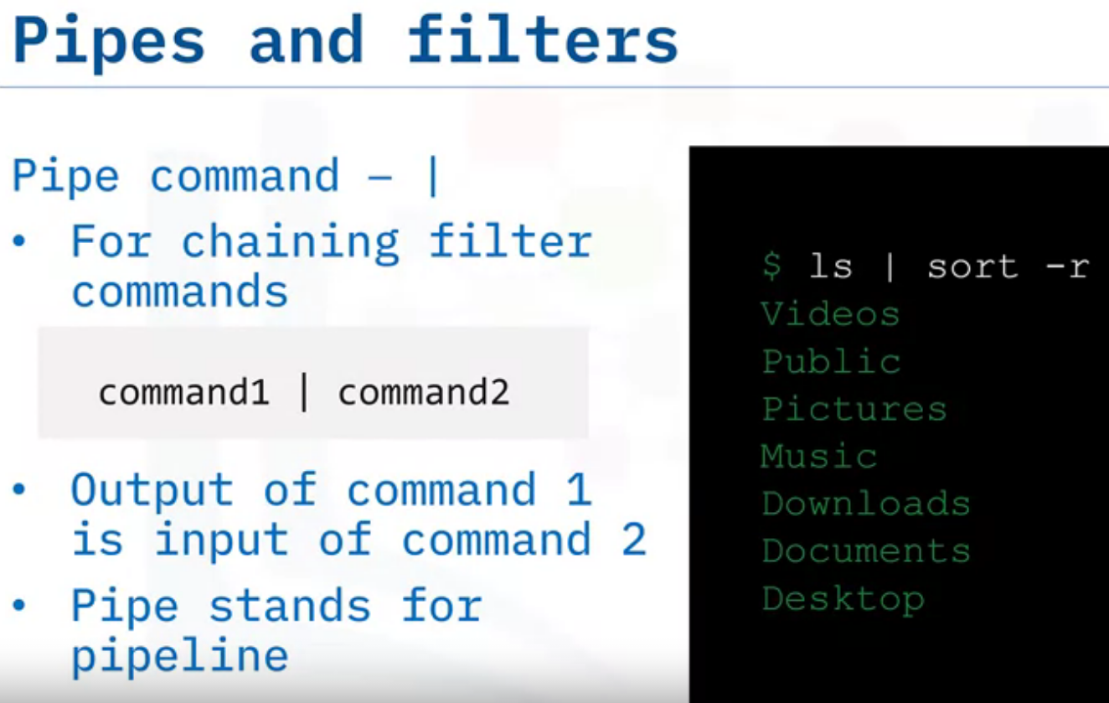
ls | sort –r : reverse sorted list

Slide 9
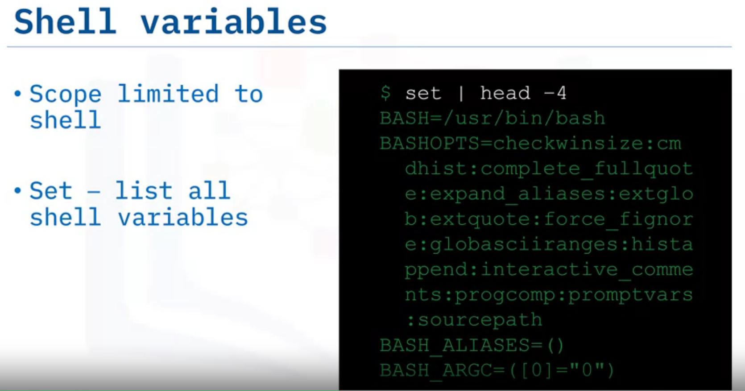
Set command: It is used to set or unset specific flags and settings( determines the behavior of the script and helps in executing the tasks without any issue.) inside the shell environment.
It can be used to change or display the shell attributes and parameters.
Using set|head -4 : ‘set’ will display shell attributes and calling ‘head -4’ will only display 4 results

Slide 10
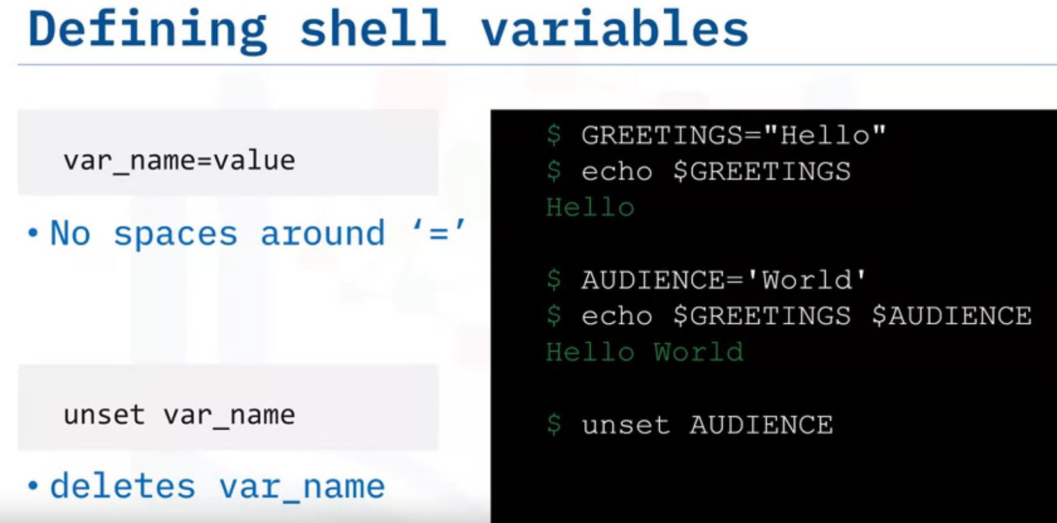
No space = Shell Variable
Notice, ‘hello ‘ is assigned to the variable ‘GREETINGS’.
By calling $ echo $GREETINGS : it will print the value stored for the variable GREETINGS
Similarly, $ echo $GREETINGS $AUDIENCE : it will print “Hello World’
BY, $ unset , we delete the result

Slide 11
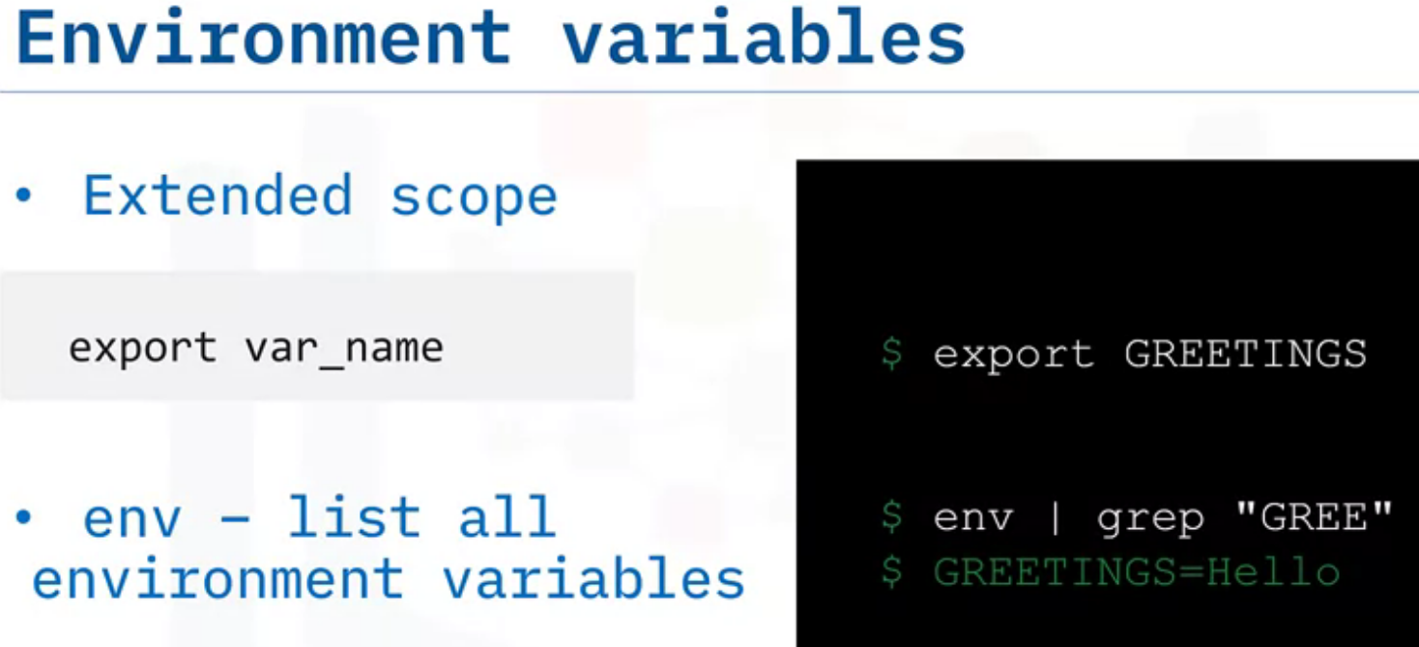
By using, ‘export’ we can extend any variable as an environment variable.
$ Export GREETINGS makes GREETINGS as an environment variable.
“env” will display all environment variable.
$ env | gerp ‘GREE’
by grepping the word ‘gree’, it will print the output as ‘Greettings=Hello’ which confirms that, it is an environment variable.

Slide 12
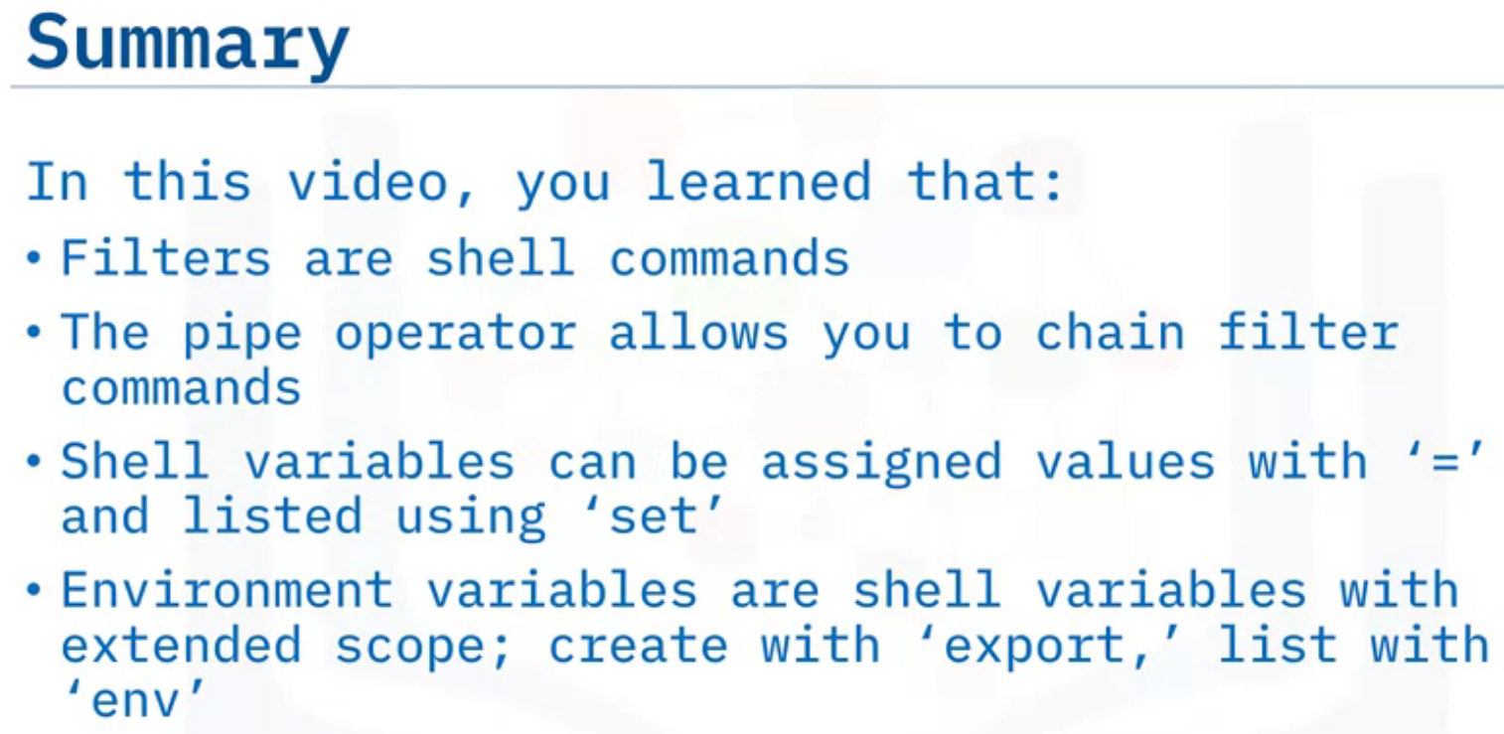

Slide 13
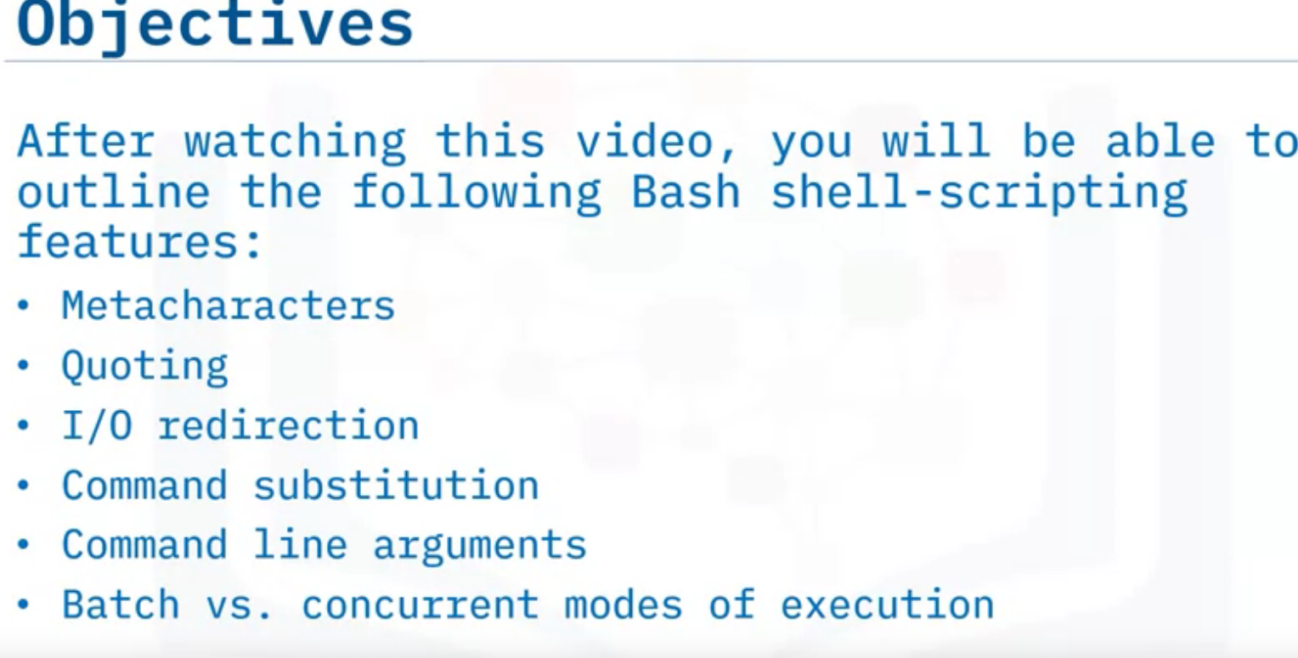
Features of Bash Shell

Slide 14
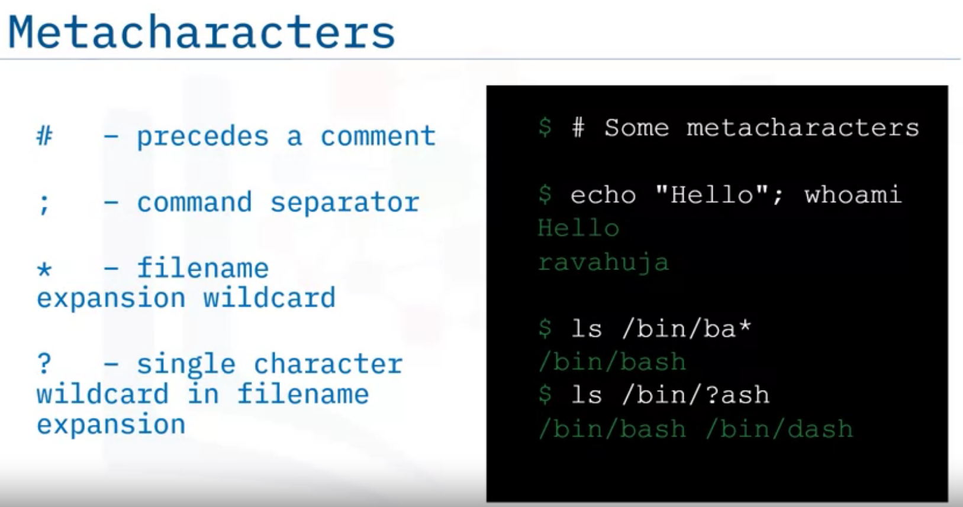
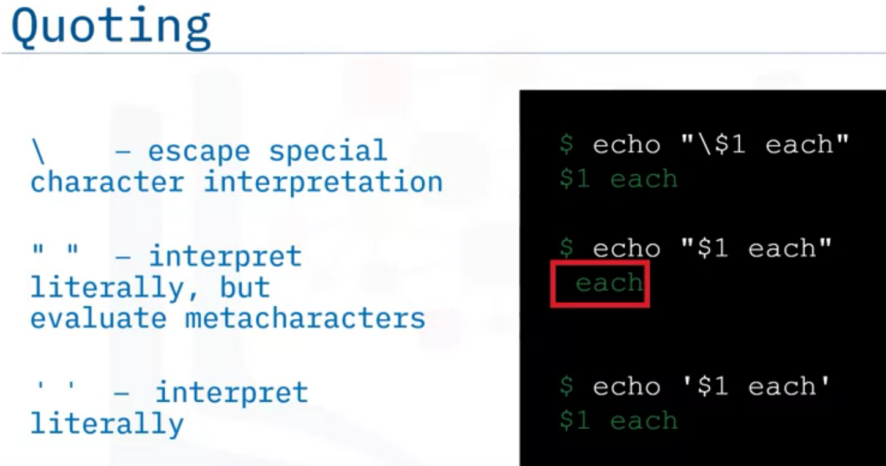

Slide 15
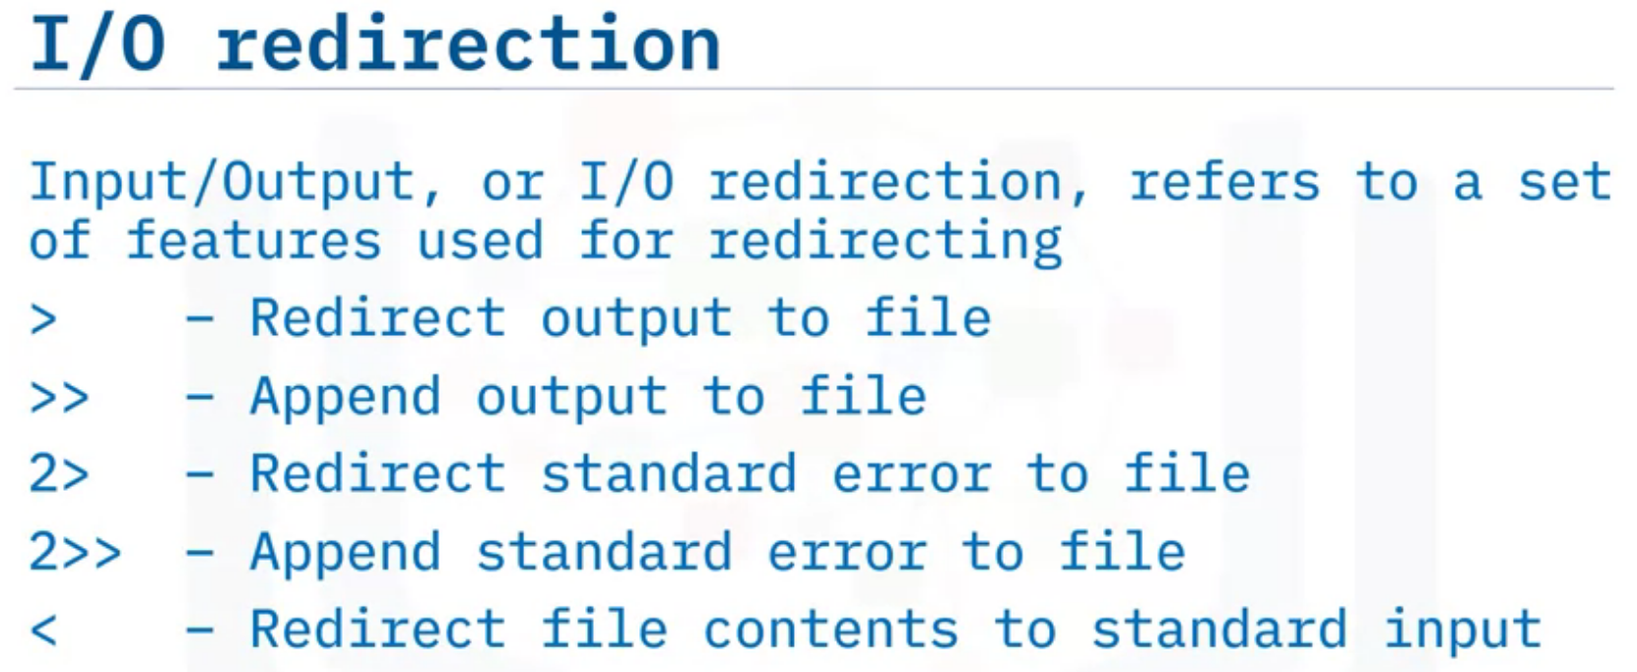
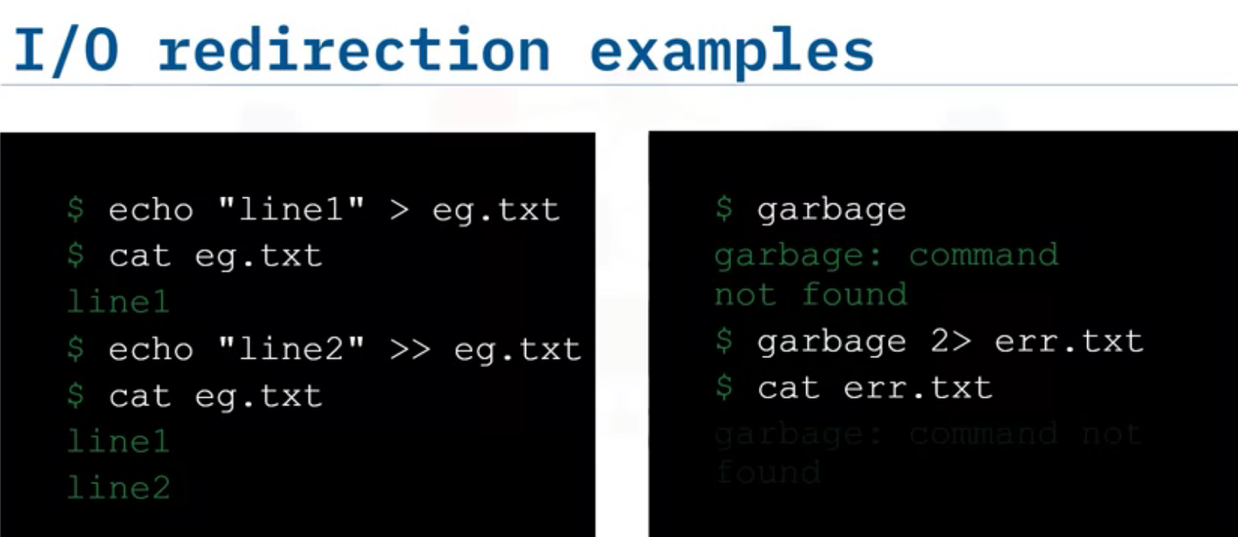

Slide 16
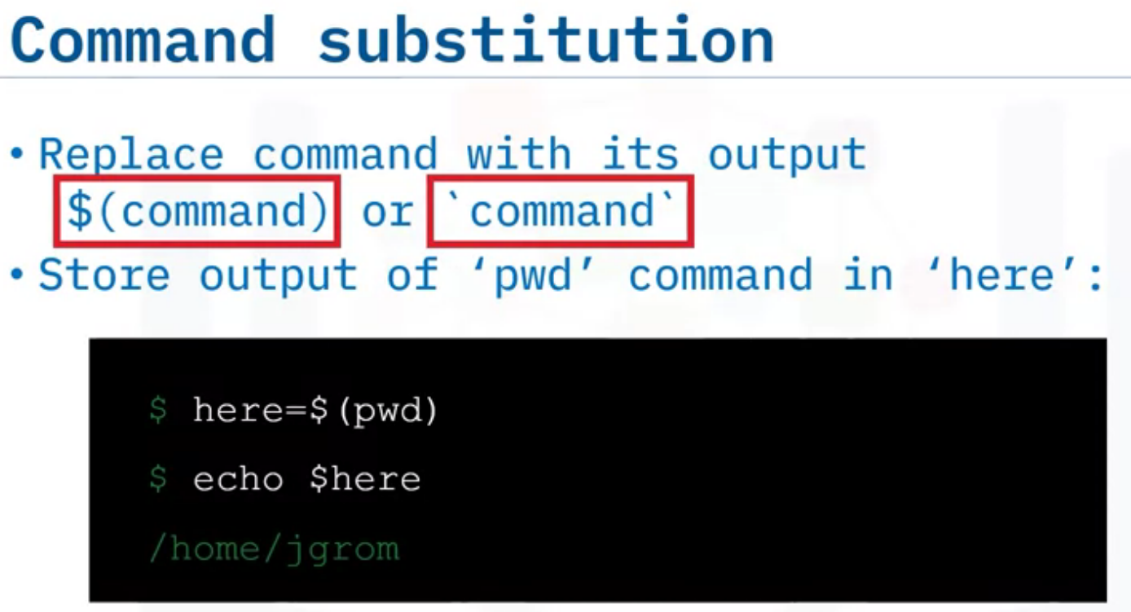
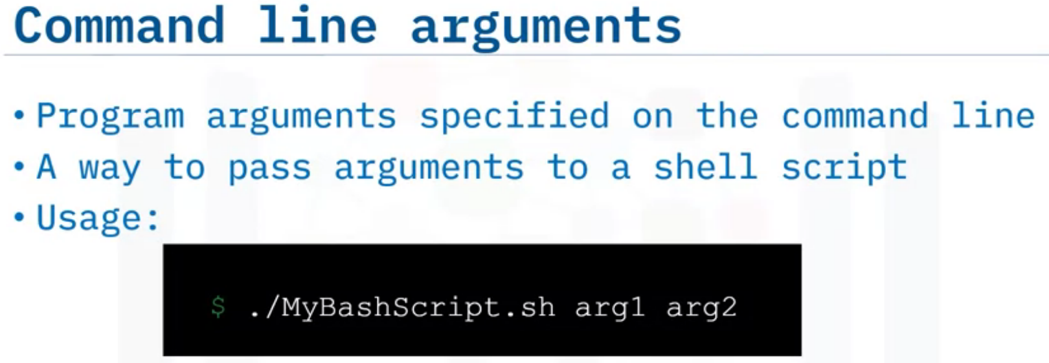

Slide 17
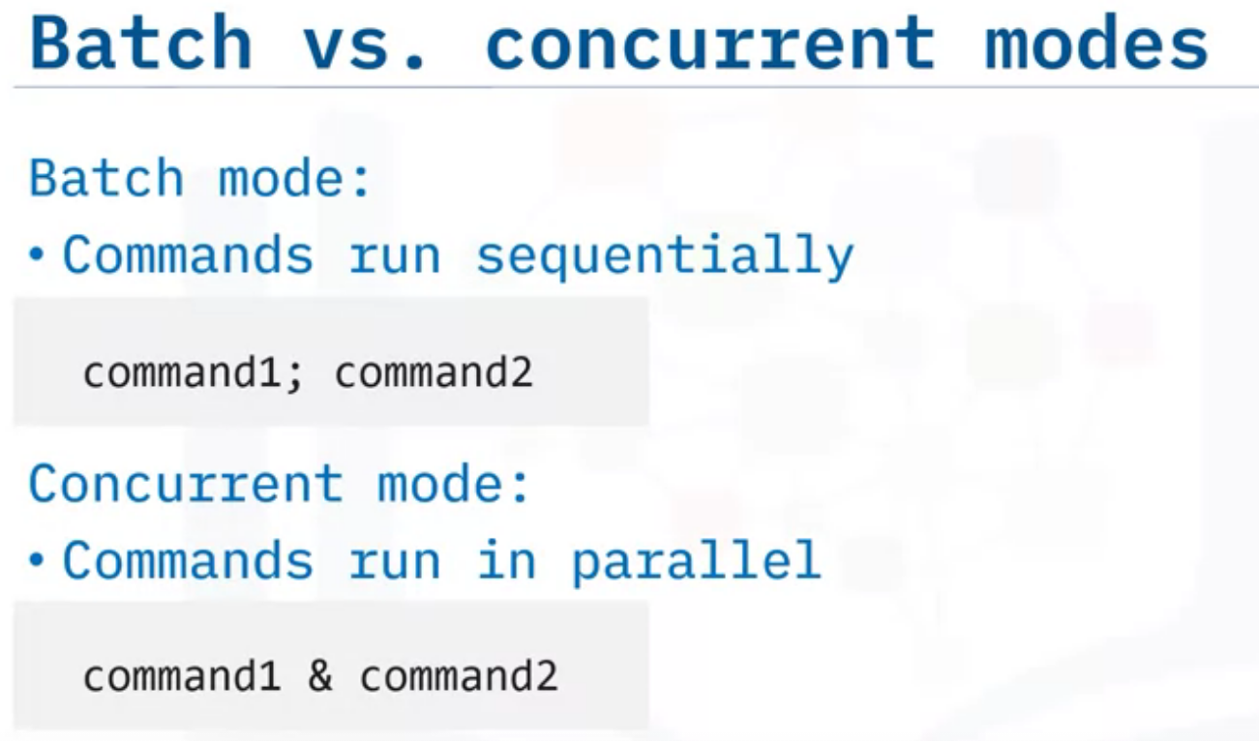
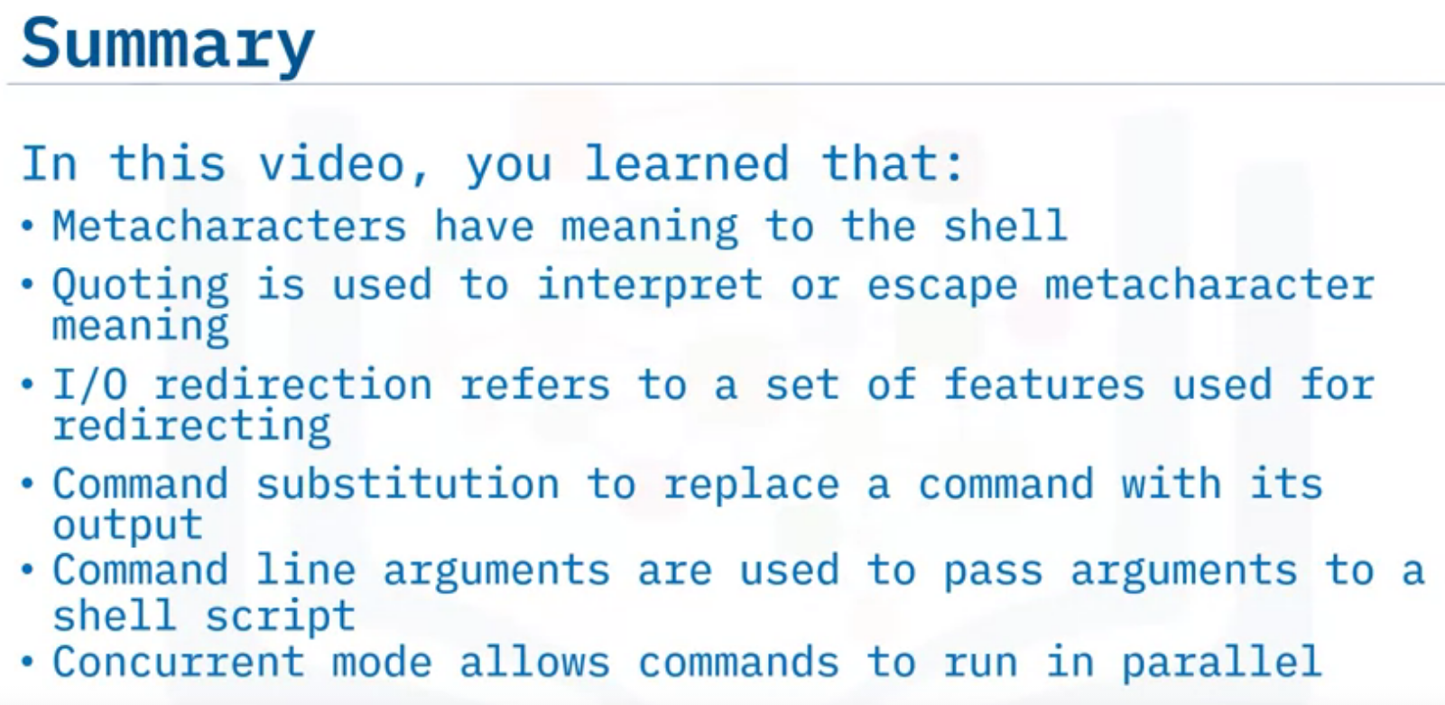

Slide 18
Scheduling Jobs using Cron

Slide 19
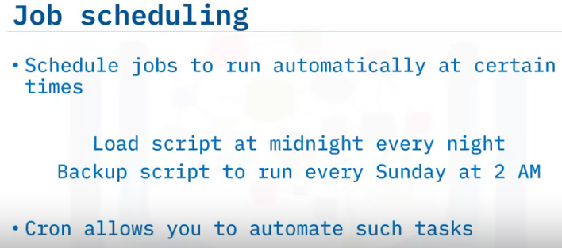
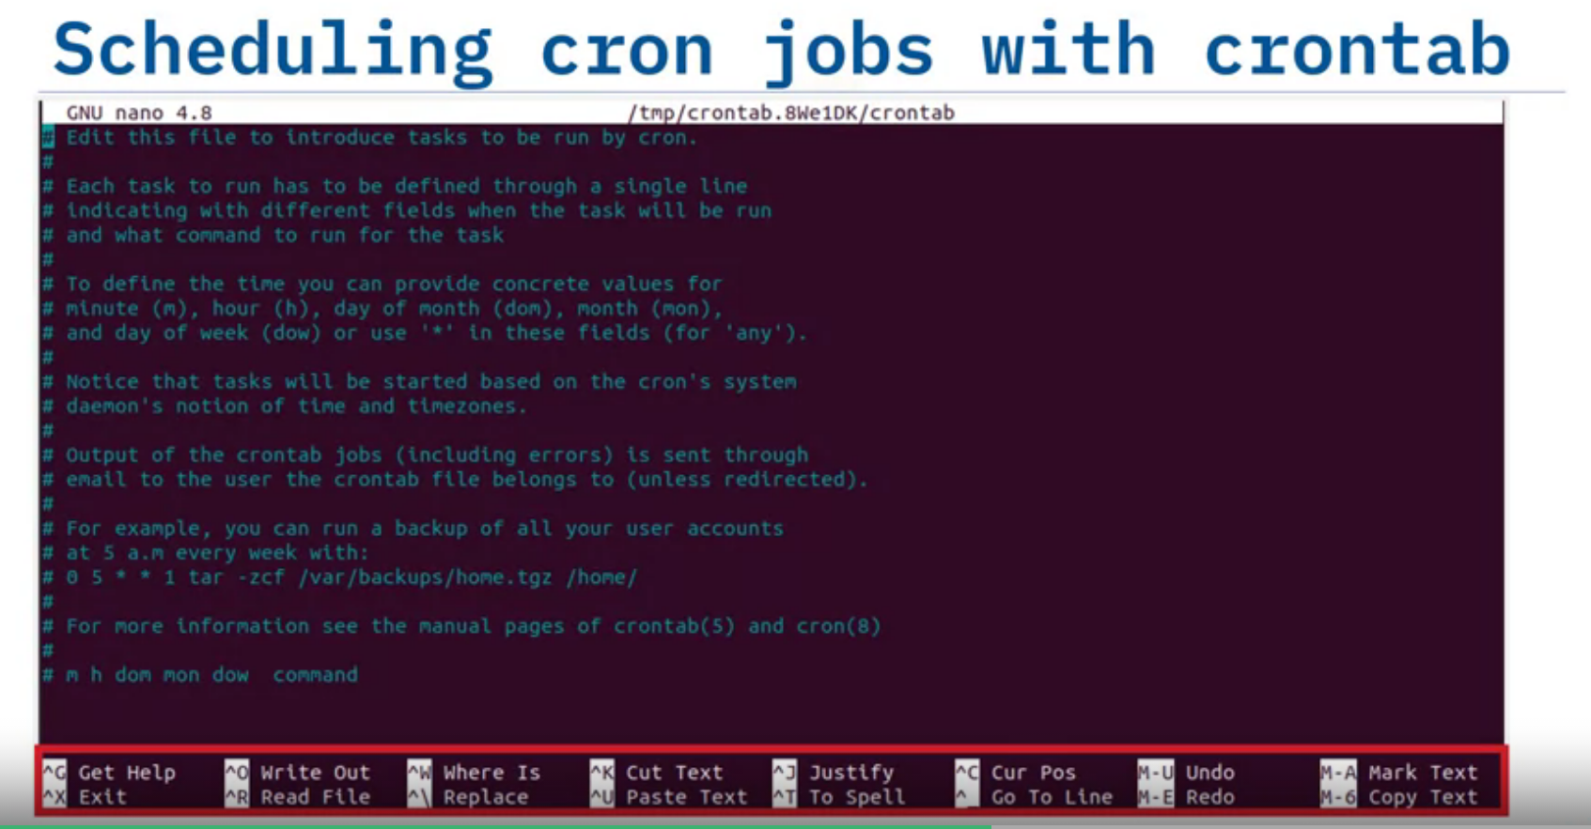
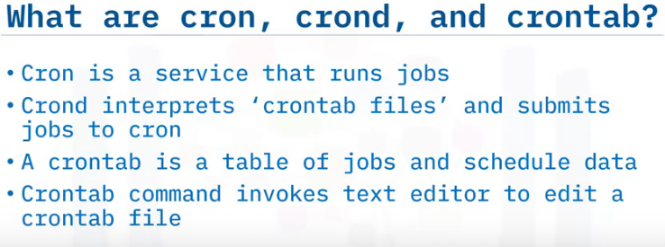
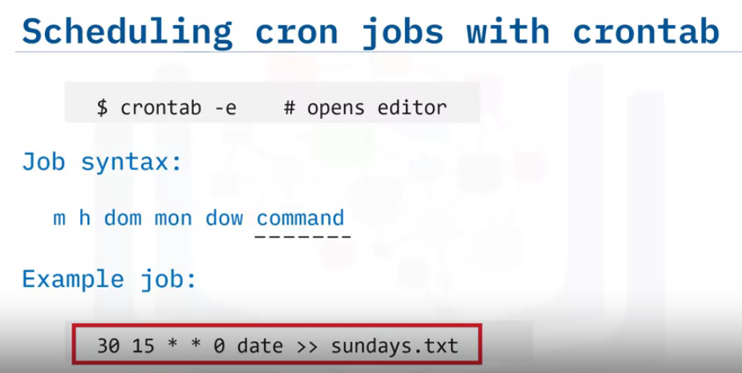

Slide 20
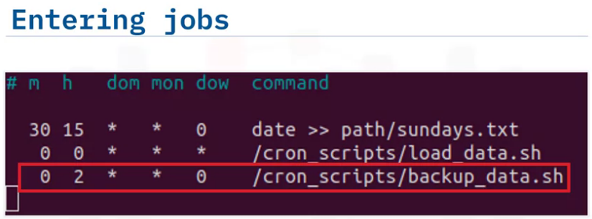
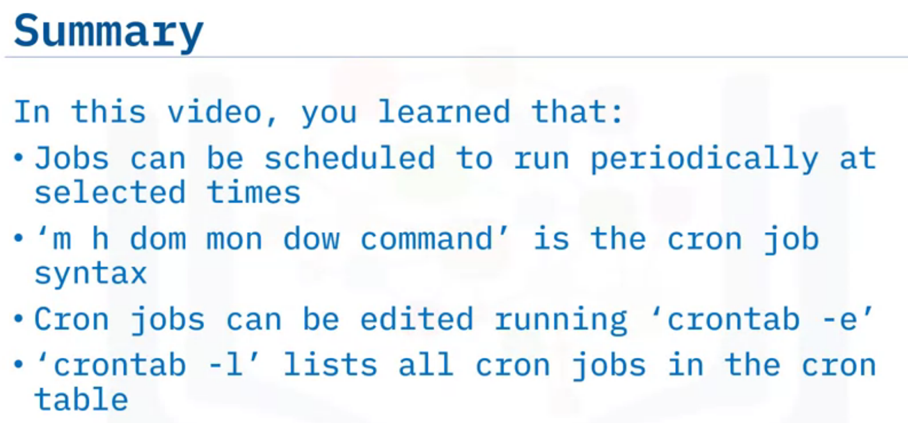
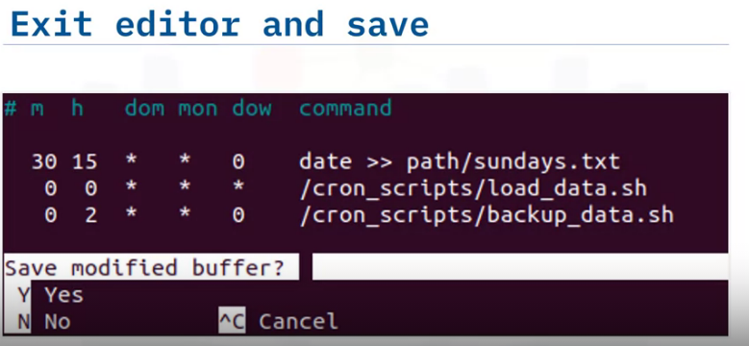
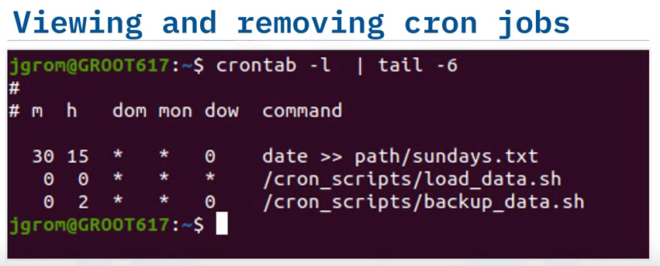

Slide 21
The correct cron job syntax is:
```
m h dom mon dow command
```
In this syntax:
- `m` refers to the minute when the cron job should be executed (0-59).
- `h` refers to the hour when the cron job should be executed (0-23).
- `dom` refers to the day of the month when the cron job should be executed (1-31).
- `mon` refers to the month when the cron job should be executed (1-12).
- `dow` refers to the day of the week when the cron job should be executed (0-7, where both 0 and 7 represent Sunday).
- `command` refers to the command or script that should be executed by the cron job.
For example, a cron job entry that runs a script every day at 8:00 AM would be:
```
0 8 * * * /path/to/script.sh
```
This cron job runs the script `script.sh` at minute 0, hour 8, every day of the month, every month, and every day of the week.

Slide 22
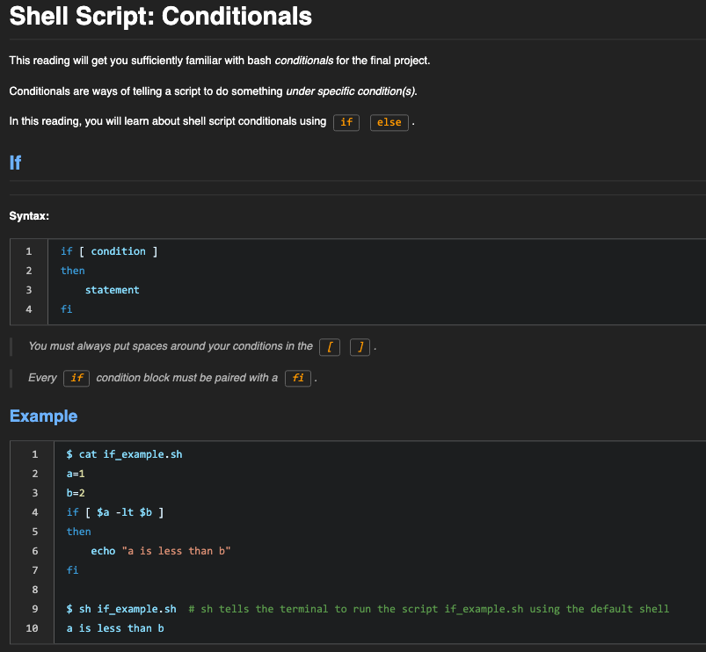

Slide 23
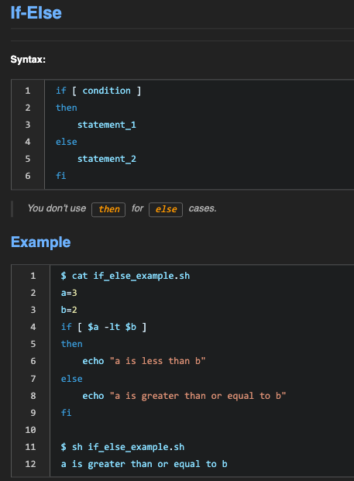

Slide 24
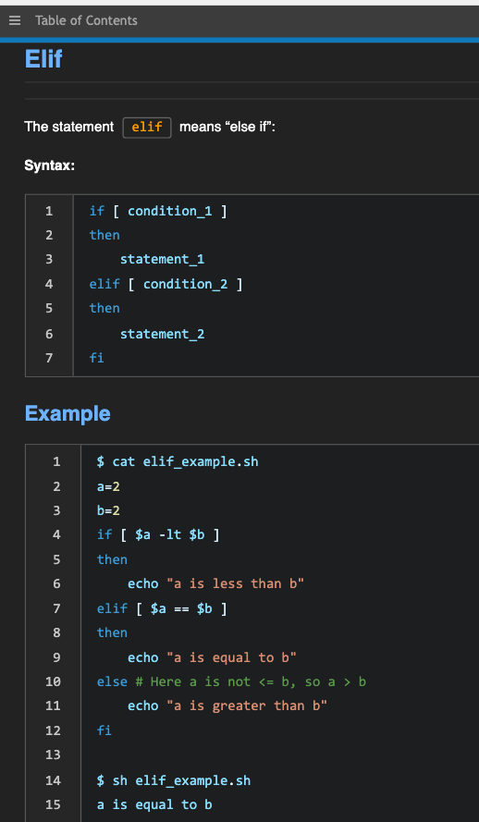

Slide 25
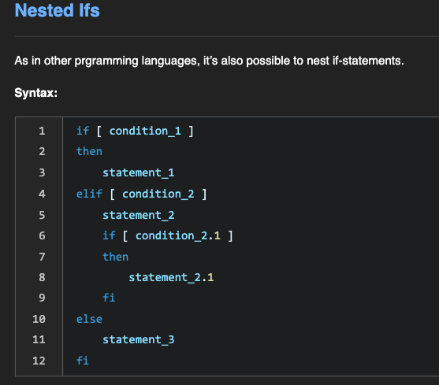
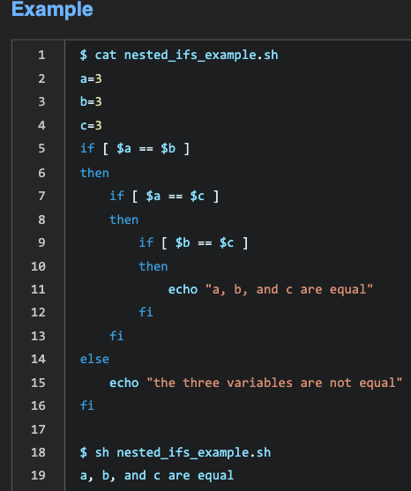
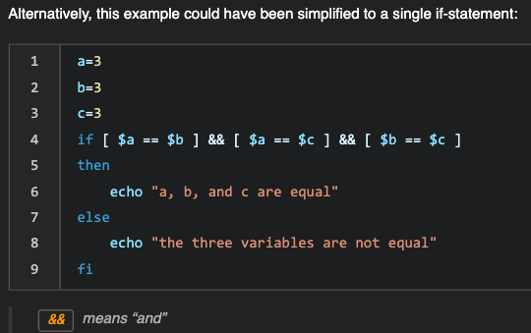

Slide 26
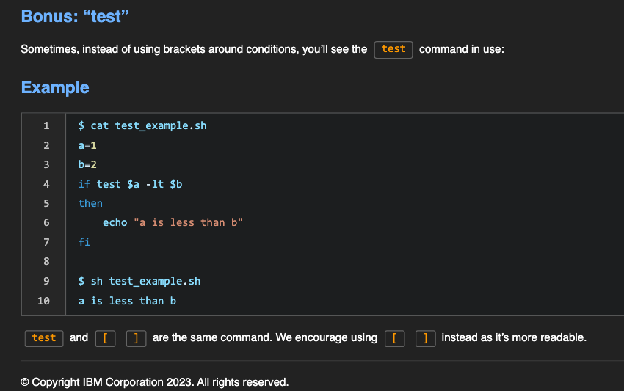

Slide 27
